Slide 1
A Project Report On
“TOURISM MANAGEMENT SYSTEM”
Submitted By
Aditya Kangare

Slide 2
CERTIFICATE
This is to certify That Mast.Aditya Kangare of T.Y.B.Sc.(Comp Sci.) has Satisfactorily carried out required project work according to the syllabus of Rao Bahadur Narayanrao Borawake College during the academic year 2025-26.

Slide 3
INDEX
SR NO | CONTENT
1 | Acknowledgement
2 | Introduction To System
3 | Scope of the System
4 | Existing System
5 | Fact Finding Technique
6 | Identification of Data
7 | Requirements Specifications
8 | Feasiblity Study
9 | Normalization
10 | UML Diagrams
11 | Data Dictionary
12 | Reports
13 | Conclusion
14 | Bibilography

Slide 4
ACKNOWLEDGEMENT
The project title Tourism Management System would not have been completed without the valuable guidance and encouragement of Prof. Dr Shinde sir.
We are also extremely thanks to Dr.B.S.Shinde sir Department of computer science & all staff members for their guidance and moral support.
We are also thankful to all those who were extremely helpful directly or indirectly in completing this project work.
And last but not least, we would like to thank all our friends for their support and timely help
Thank you …
You’re sincerely ,
Mast.Aditya Kangare

Slide 5
INTRODUCTION TO SYSTEM
In the dynamic landscape of the travel and tourism industry, the need for efficient, seamless, and customer-centric solutions has never been greater. The Tourism Management System (TMS) represents a significant step towards addressing these needs by offering a comprehensive and integrated platform for managing various aspects of travel planning, booking, and coordination.
The TMS is envisioned as a transformative tool that empowers travel agencies, tour operators, and tourists alike with advanced features and functionalities. By leveraging cutting-edge technology and innovative design, the system aims to revolutionize the way travel-related services are accessed, organized, and delivered.

Slide 6
SCOPE OF THE SYSTEM
The scope of the Tourism Management System (TMS) encompasses a wide range of functionalities and features aimed at facilitating and enhancing various aspects of travel planning, booking, and coordination. The system is designed to cater to the needs of tourists, travel agencies, tour operators, accommodations, transportation providers, and other stakeholders within the travel and tourism industry. Key components of the system's scope include.

Slide 7
EXISITNG SYSTEM
The current state of the tour and travel management industry relies heavily on manual processes, disjointed systems, and fragmented communication channels. While some tourism agencies and tour operators may use basic software solutions for specific tasks such as booking accommodations or arranging transportation, the overall landscape lacks a comprehensive and integrated system that addresses the diverse needs of tourists, service providers, and other stakeholders.

Slide 8
FACT FINDING TECHNIQUE
To gather requirements and insights for the development of the Tourism Management System, a variety of fact-finding techniques were employed:
Interviews with key stakeholders including tourists, travel agents, hotel managers, and tourism officials obtained from Youtube
Surveys and questionnaires distributed to potential users to gather feedback and preferences taken from Google
Observations of existing processes and interactions within the tourism industry
Analysis of documents such as industry reports, market trends, and competitor offerings

Slide 9
INDENTIFICATION OF DATA
Key data entities identified within the Tourism Management System include:
Tourists: Personal information, preferences, booking history, etc.
Accommodations: Hotel details, room types, availability, pricing, etc.
Destinations: Points of interest, attractions, geographic information, etc.
Bookings: Reservation details, itinerary, payment status, etc.
Transportation: Flight schedules, train routes, car rental options, etc.
Payments: Transaction records, billing information, payment methods, etc.

Slide 10
Software And Hardware Specifications:
Hardware Specification:
Processor : core i5
Ram : 4.00 GB.
SSD : 256 GB.
Software Specification:
Frontend : Html, CSS, JavaScript, Bootstrap Web Servers : WampServer.
Backend : PHP, MYSQL.
Browser
Program : Google Chrome, Mozilla Firefox.

Slide 11
Feasibility Study
A feasibility studies main goal is to access the economics visibility of the proposed business. The study should provides a tough analysis of the business opportunity, including a look at all possible roadblocks that may stands in the way of the co-operatives success. The outcome of the feasibility study will indicate whether or not proceed with the proposed system.
If is results of the feasibility study are positives, then we can processed to develop the system software.
If the result show that the project should not should a business idea, and them the project should not carried on further.
These are the major aspects feasibility study
Technical Feasibility:
This area concerns with both the initial purchase and installation cost as well as the operational costs
of running the system. Our proposed system will technically
feasible because any additional hardware or software requirement will not be needed for it.
Economical Feasibility:
The system will be economically feasible because if the following reasons. We are going to use browser. After detailed system will be made available freely and whatever the cost incurred, it will be very less to benefits.
Operational Feasibility:
The proposed system after implementation will satisfy the required goals besides providing many other facilities. The system will be easy the understand. Automatic validation of input will enhance to operational feasibility further more.
Our output screens are familiar with their existing data processing environment from the beginning system operations will be made easy for them.

Slide 12
Normalization
  Need for Normalization:-
Normalization reduces the redundancies of the records. So we can handle the database more efficiently by using relationships between them. By using the normalization we get accurate and consistent results.
    1NF :- It Remove duplicate records from tables.
    2NF :- It check that every non-key field is strictly depends on key field.
    3NF :- In this normal form transitive dependencies in the field are removed.

Slide 13
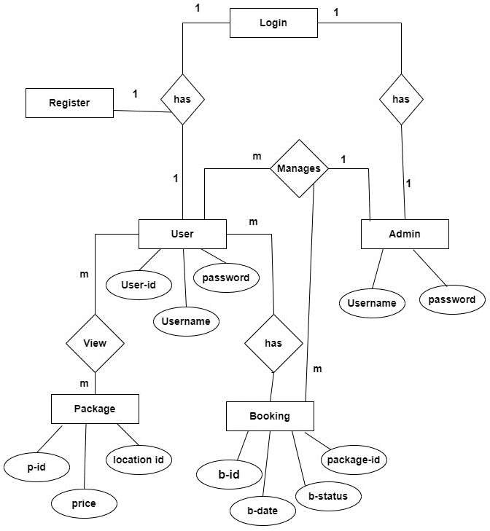
UML Diagram
E-R Diagram :

Slide 14
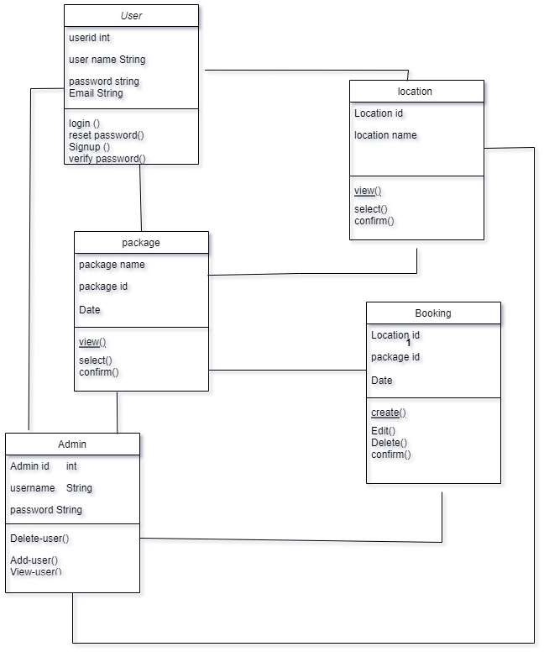
Class Diagram:

Slide 15
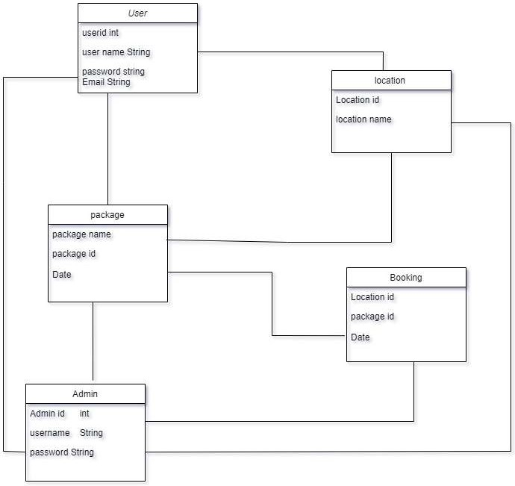
Object diagram:

Slide 16
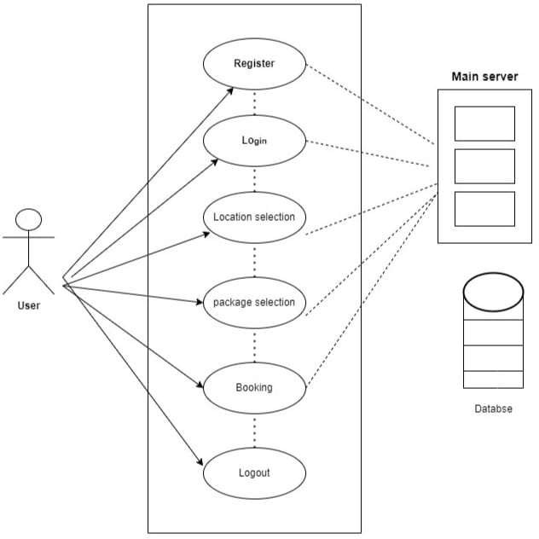
Use case diagram:

Slide 17
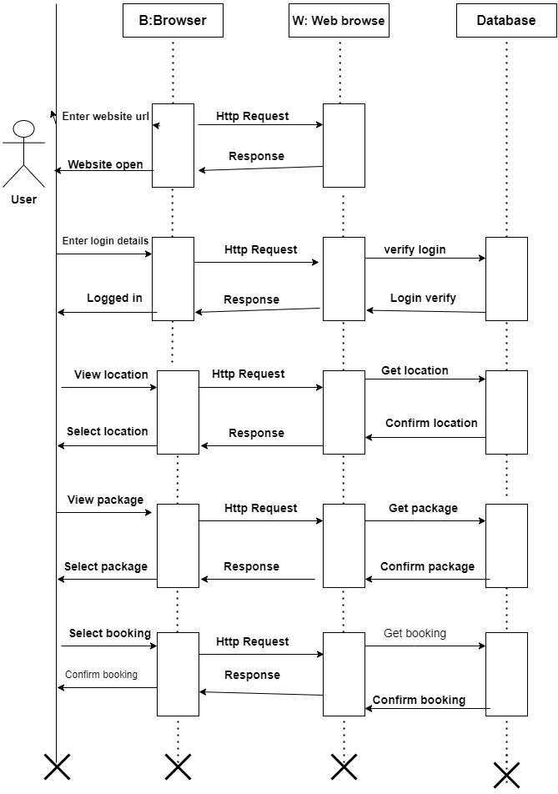
Sequence diagram:

Slide 18
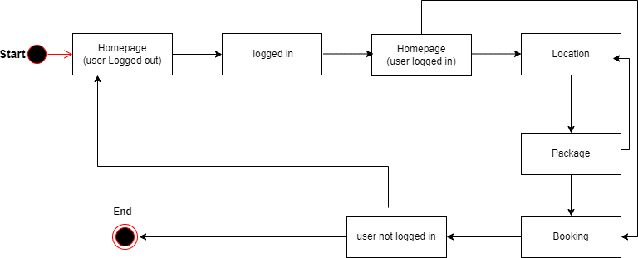
State Chart Diagram

Slide 19
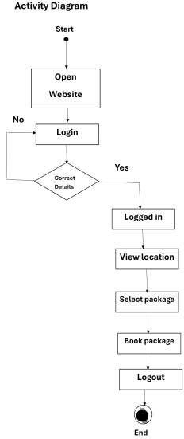
Activity diagram:

Slide 20
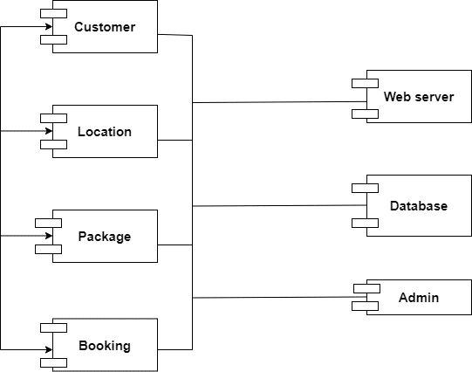
Component Diagram

Slide 21
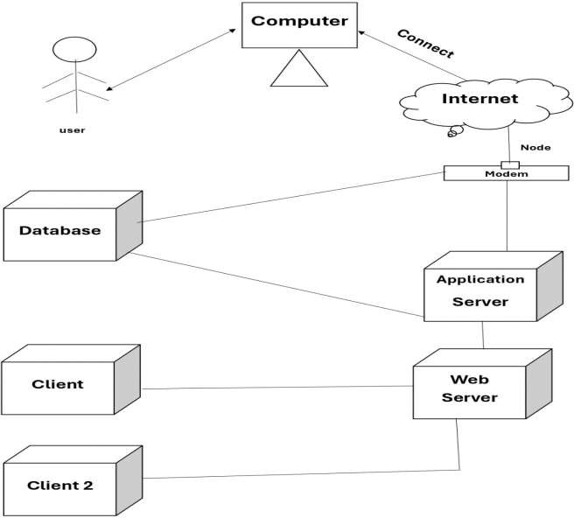
Deployment diagram:

Slide 22
Data Dictionary
Fields | Data Type | Description | Constraints
User_id | Int | Id of the user | Primary key
Email_id | Varchar | Email of the user | Not null
Password | Varchar | Password for the user login | Not null

Slide 23
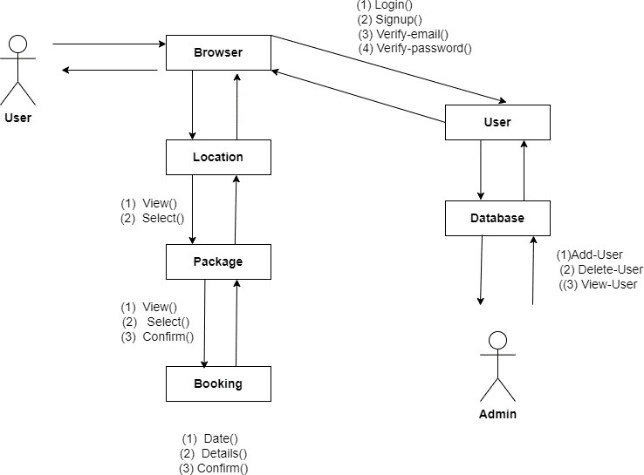
Collabration Diagram

Slide 24
Conclusion
This mini project has met its Objectives to demonstrate the working concept Of Tourism Management System. The development of thisproject was very helpful in developing our programming skills.
The project helped us to understand HTML and CSS and Bootstrap to greater depth. We found designing and developing this PROJECT interesting and a good learning experience. It helped us to learn about design Of web page

Slide 25
Bibliography:-
The following Books and websites were used as reference forthe Project and preparing this Project Report:
www.w3school.com- This is a idea that exist a class of renders who response Better to learn new technologies at our own place. It provides tutorials for HTML, CSS and PHP which help in building websites.
www.geeksforgeeks.com- This is an educational website for learning web Technologies online. Content includes tutorial and references relating to HTML ,CSS,PHP ,Bootstrap etc.

